Slide 1
OreSat CFC
DN

Slide 2
Assumptions
Use Princeton’s TEC specification
Keep detector at -10C (263K) with body orbital average temperature of 301K
With radiator design, run three cases: 1U, 2U, and 3U sizes, all with dedicated radiator side

Slide 3
Thermal load – no radiator
Converted detector to boundary condition @ -10C to get required heat load
Simulation suggests ~5.4W needs to be removed through the TEC to maintain -10C temperature

Slide 4
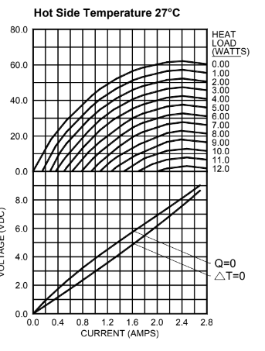

TEC power – heat sink design
Estimate TEC power to achieve this ΔT using TEC curves
You can see with a 5W heat load, this TEC can never achieve a 40K ΔT
We can get close by applying ~2.4A @ 7.5V
This brings total maximum refrigeration load entering thermal mass to 23.4W

Slide 5
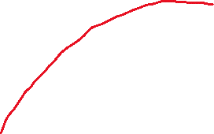
TEC power – radiator design
Very quick and dirty radiator redesign calculations and sims give promising results
With radiator, load needed to be removed is only ~0.3W (provided radiator can be pointed to space) and ΔT of only 28K
Gives TEC power of ~1.4W and total refrigeration load of roughly 1.7W, almost a factor of 14 less than that of the heat sink design

Slide 6

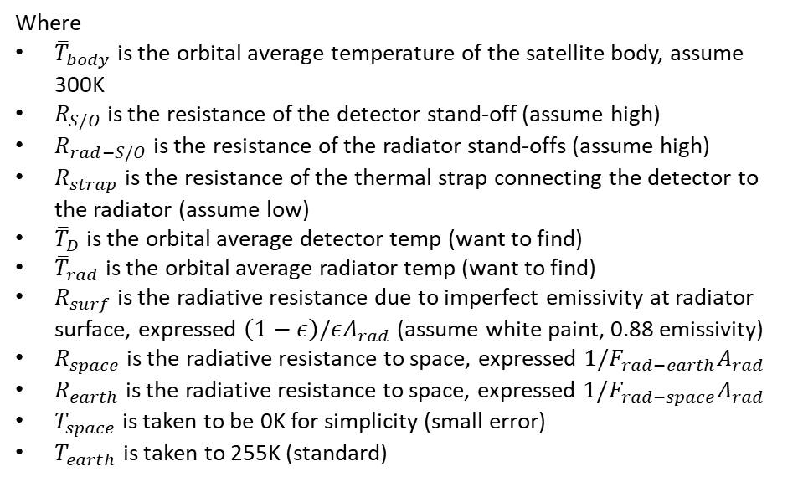










Radiator Sizing
Steady-state energy balance on radiator to determine its temperature and the detector temperature
For first pass, assume we are able to point to radiator space (i.e. no direct sunlight on radiator)
Where
${\overline{T}}_{body}$ is the orbital average temperature of the satellite body, assume 300K
$R_{S/O}$ is the resistance of the detector stand-off (assume high)
$R_{rad−S/O}$ is the resistance of the radiator stand-offs (assume high)
$R_{strap}$ is the resistance of the thermal strap connecting the detector to the radiator (assume low)
${\overline{T}}_{D}$ is the orbital average detector temp (want to find)
${\overline{T}}_{rad}$ is the orbital average radiator temp (want to find)
$R_{surf}$ is the radiative resistance due to imperfect emissivity at radiator surface, expressed $\left(1−ε\right)/εA_{rad}$ (assume white paint, 0.88 emissivity)
$R_{space}$ is the radiative resistance to space, expressed $1/{F_{rad−earth}A}_{rad}$
$R_{earth}$ is the radiative resistance to space, expressed $1/{F_{rad−space}A}_{rad}$
$T_{space}$ is taken to be 0K for simplicity (small error)
$T_{earth}$ is taken to 255K (standard)
$${\overline{T}}_{body}$$
$$T_{space}$$
$$R_{S/O}$$
$$R_{rad−S/O}$$
$$R_{space}$$
$${\overline{T}}_{D}$$
$$R_{strap}$$
$${\overline{T}}_{rad}$$
$$R_{surf}$$
$$R_{earth}$$
$$T_{earth}$$

Slide 7
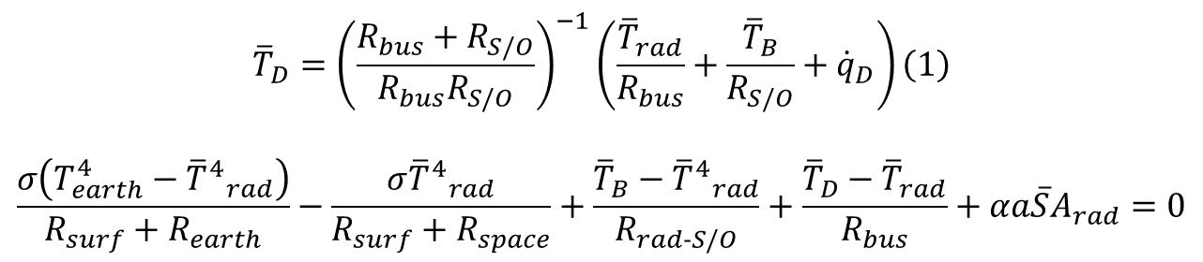
Radiator Sizing
Putting it together, ignoring albedo and radiation exchange between the back side of the radiator and body (i.e. conduction only):
$$\begin{aligned}{\overline{T}}_{D}={\left(\frac{R_{bus}+R_{S/O}}{R_{bus}R_{S/O}}\right)}^{−1}\left(\frac{{\overline{T}}_{rad}}{R_{bus}}+\frac{{\overline{T}}_{B}}{R_{S/O}}+{\dot{q}}_{D}\right)\#\left(1\right)\end{aligned}$$
$$\frac{σ\left(T_{earth}^{4}−{{\overline{T}}^{4}}_{rad}\right)}{R_{surf}+R_{earth}}−\frac{σ{{\overline{T}}^{4}}_{rad}}{R_{surf}+R_{space}}+\frac{{\overline{T}}_{B}−{{\overline{T}}^{4}}_{rad}}{R_{rad−S/O}}+\frac{{\overline{T}}_{D}−{\overline{T}}_{rad}}{R_{bus}}+αa\overline{S}A_{rad}=0$$
Sub eqn (1) in here
2 eqns and 2 unknowns; can now use guess-and-check to find steady-state orbital average radiator temperature and then find detector temperature from there

Slide 8
Radiator Sizing
Guess-and-check and finding 0 net heat point gives us an orbital average steady-state temperature of 278K and 265K for 1- and 2U-sized radiators, respectively
Quick TD simulation validates these calculations within 1% error
Detector temperatures run very close to radiator temperature with 0.3W/K thermal strap connection

Slide 9
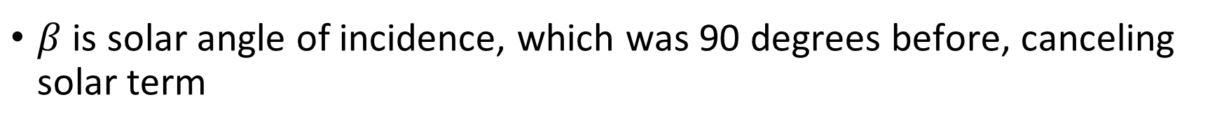
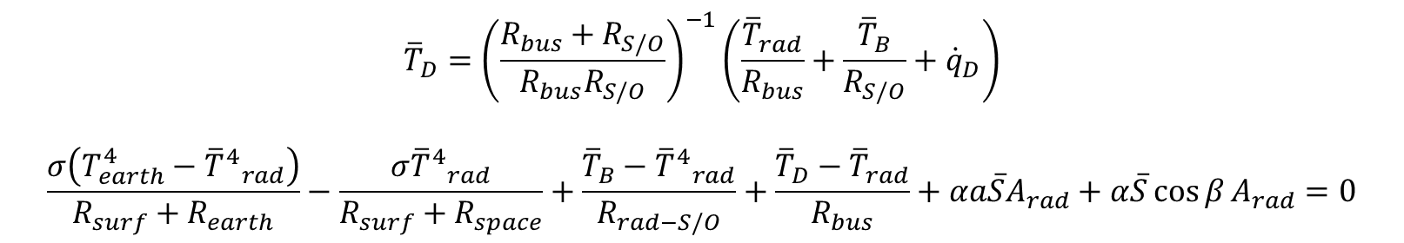
Effect of Solar Incidence on Radiator
Now repeat this for varying degrees of solar incidence
Equations now becomes:
$$\begin{aligned}{\overline{T}}_{D}={\left(\frac{R_{bus}+R_{S/O}}{R_{bus}R_{S/O}}\right)}^{−1}\left(\frac{{\overline{T}}_{rad}}{R_{bus}}+\frac{{\overline{T}}_{B}}{R_{S/O}}+{\dot{q}}_{D}\right)\#\#\#\end{aligned}$$
$$\frac{σ\left(T_{earth}^{4}−{{\overline{T}}^{4}}_{rad}\right)}{R_{surf}+R_{earth}}−\frac{σ{{\overline{T}}^{4}}_{rad}}{R_{surf}+R_{space}}+\frac{{\overline{T}}_{B}−{{\overline{T}}^{4}}_{rad}}{R_{rad−S/O}}+\frac{{\overline{T}}_{D}−{\overline{T}}_{rad}}{R_{bus}}+αa\overline{S}A_{rad}+α\overline{S}\cos{β}A_{rad}=0$$
$β$ is solar angle of incidence, which was 90 degrees before, canceling solar term

Slide 10
Effect of Solar Incidence on Radiator
Shows up to 14˚ C difference in radiator temperature depending on attitude

Slide 11
Initial Conclusions
If attitude is properly controlled, early simulations suggest that detector can be passively cooled to within a couple degrees of the target temperature
A TEC can then be used (perhaps with ability to reverse current) to stabilize temperature at low power
(Based on CAD I had access to) Cu thermal mass was about 1kg
With 2U radiator and thermal strap, the thermal system is roughly estimated between 150 and 350g

Slide 12
Different Radiator/Attitude Configurations
Can combine effects of these scenarios to get an average detector temperature if we ended up putting multiple 1U radiators on separate faces
Different variations are shown below with satellite “split open” to show each side
(1)
2 1U radiators,
No incident sunlight
(2)
2 1U radiators,
incident sunlight
(3)
4 1U radiators,
2 with incident sun
(4)
4 1U radiators,
All with incident sun
Earth-sun vector
CFC
CFC
CFC
CFC

Slide 13
Different Radiator Configurations
Running steady-state orbital average simulations:
Rad config | Orbital Average Detector Temperature (°C) | Thermal System Mass Estimate (kg)
Single 2U, no sun | -8 | 0.155*
(1) | 1.5 | 0.185**
(2) | 6 | 0.155**
(3) | 0 | 0.620***
(4) | 1 | 0.620***
* Assumes single 2U (~152cm² surface area, 3mm thick) Aluminum radiator with 30g heat strap
** Assumes 2X 1U (~76cm² each) Aluminum radiators with 2X 30g heat straps
*** Assumes 4X 1U (~76cm² each) Aluminum radiators with 4X 30g heat straps

Slide 14
Different Radiator Configurations Conclusions
Lowest mass, highest risk*
Medium mass, medium risk
Higher mass, low risk
CFC
CFC
CFC
Thermal System Mass: 155g
Minimum Orbital average: -8°C
Maximum orbital average: 6°C
Thermal System Mass: 185g
Minimum Orbital average: 1.5°C
Maximum orbital average: 6°C
Thermal System Mass: 620g
Minimum Orbital average: 0°C
Maximum orbital average: 1°C
* “Risk” defined here as degree of attenuation as a result of poor attitude control

Slide 15
Different Radiator Configurations Conclusions
So far, the single 2U (without any incident sun) is the only one I am confident we can run the TEC indefinitely with
With this config, estimate we can run the detector at stable 265K while maintaining 272K on the TEC hot side and 267K at the radiator and orbital average TEC power of 1.2W
Confident at this point that all other configurations/attitudes will only be able to be powered transiently – our acquisition duration for these configurations is still TBD

